Slide 1

BFX-AT100 LED issue 8D report
FOXCONN CPEG JBD_VN
Mar-30-2021

Slide 2
D1. Establish the Team
Team Leader
Team Member
OTT:
  QA Manager :
PM: Ben Zheng, Lam Zhou
PD: Ruan Wen Yong
QA: Rachel Nguyen, Robert Wu
SQE: Chun Ke
IE: Hai Ly
Foxconn
  MFG Manager : David Yin
  QA Manager : Charlie Su/ CB Lin

Slide 3
D2. Description of Problems
Issue Description
Feb-2021, ALT customer complain LED ( Yellow & Purple ) issue on RMA center:
20-Fed-2021, Everlight received from Fii 7 pcs LED issue ( Yellow & Purple) for analysis root cause and Fii retained 1 pc for analysis. The detailed information is as below:
Type | SN | Production_Time | Vendor(Everlight) Lot Code | Vendor(Everlight) Date Code
Yellow | 2149688001201904040599 | 09/18/2019 15:50:01 | Y190730S1002DF | 190730
 | 2149688001201904024318 | 09/16/2019 05:40:20 | Y190730S1002DF | 190730
 | 2149688001201904032610 | 09/15/2019 16:02:53 | Y190730S1002DF | 190730
 | 2149688001201904017454 | 09/12/2019 08:20:13 | Y190730S1002DF | 190730
Purple | 2149688001201909023362 | 11/06/2019 16:21:41 | Y190914G1001DDFWX35 | 190914
 | 2149688001201908031823 | 10/12/2019 16:14:21 | LY190817S1002DDFWX35 | D190817
 | 2149688001201904035168 | 09/17/2019 03:01:02 | Y190730S1002DF | 190730
 | 2149688001201904041675 | 09/19/2019 03:15:47 | Y190730S1002DF | 190730

Slide 4


D3. Containment
Check production data and shipping data
Production data : 8 Units no have rework or repair data, all doing follow normal process:
TT | SN | Production_Time | Invoice_No | Shipping_Time
1 | 2149688001201908031823 | 10/12/2019 16:14:21 | 5028016106 | 10/17/2019 3:38:10 PM
2 | 2149688001201909023362 | 11/06/2019 16:21:41 | 5028016338 | 11/8/2019 8:07:30 PM
3 | 2149688001201904017454 | 09/12/2019 08:20:13 | 5028015723 | 9/12/2019 1:44:15 PM
4 | 2149688001201904024318 | 09/16/2019 05:40:20 | 5028015801 | 9/18/2019 4:00:13 PM
5 | 2149688001201904035168 | 09/17/2019 03:01:02 | 5028015801 | 9/18/2019 4:00:13 PM
6 | 2149688001201904040599 | 09/18/2019 15:50:01 | 5028015800 | 9/18/2019 4:15:54 PM
7 | 2149688001201904032610 | 09/15/2019 16:02:53 | 5028015802 | 9/19/2019 5:04:34 AM
8 | 2149688001201904041675 | 09/19/2019 03:15:47 | 5028015802 | 9/19/2019 5:04:34 AM
Inspection at FT: Check LED color following SOP/ Quality alert and use golden sample for comparison.

Slide 5
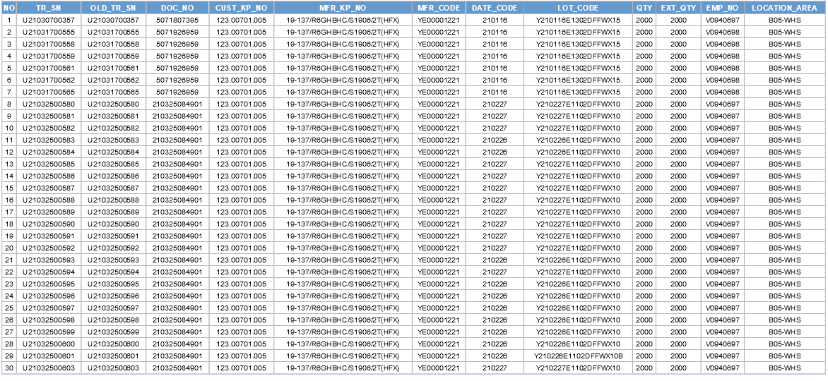
D3. Containment
Check all LED Material in Warehouse with 123.00701.005 – 26-Mar-2021 .
Result : Check 60K material ( 123.00701.005 ) Everlight vendor in warehouse , All is DC 202101 and 202102. No DC 190730, 190914, 190817 Led issue.

Slide 6
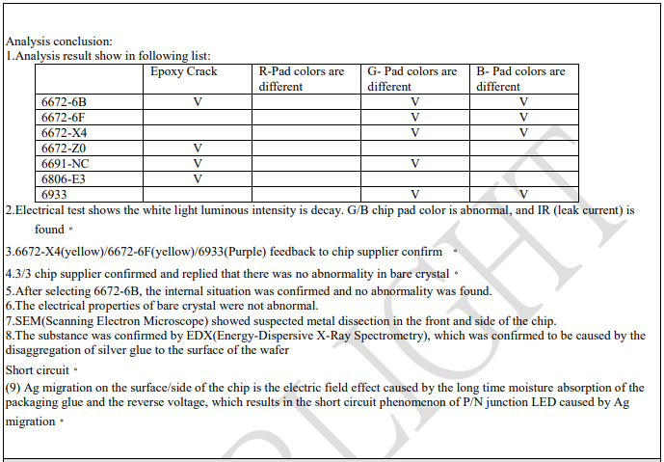

D4. Root Cause ( Everlight FA)
FA report 7 pcs NG sample analysis

Slide 7
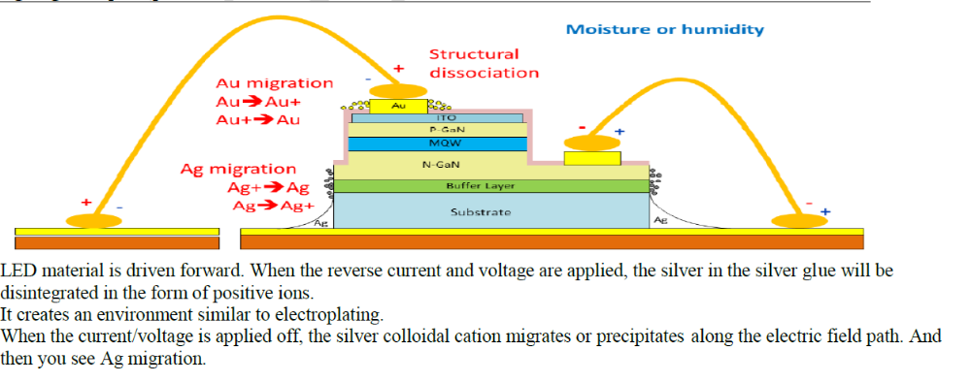
D4. Root Cause
Ag migration explanation

Slide 8
D5. Corrective Action ( Everlight vendor action)
Everlight will evaluate the solution of changing the bottom solid crystal adhesive into insulating adhesive.
The schedule from Everlight is as follows:
-Issue trial production order/material requisition-3/30
-The trial production of the project was completed-4/9
-Send samples to Fii-4/10
-Provide project trial production report-4/15
-Reliability Analysis Report-5/28
-Customer approve to introduce -6/4
-The 1st lot of new part ETD Everlight factory- 7/17
-Fii introduces into August production

Slide 9



D6. Verification of effectiveness
Quality alert and SOP were already updated inspection requirement and hang on production line, IPQC keep audit and verifying the implementation on production line.
SOP check LED on Test Function
FT1 Test Station | FT Test Station | RC Test Station | OBA Test Station | Quality Alert

Slide 10
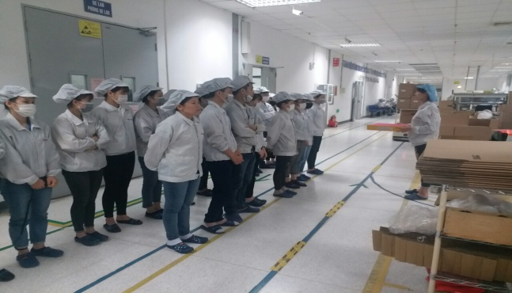
D7. Prevent recurrence
Line leader remind all operators before production and monitor their operating daily.
IPQC will random sample check all test station and OBA station follow AQL .
Owner: PD/PQE: Huu Loi, Luu Mien

